Slide 1

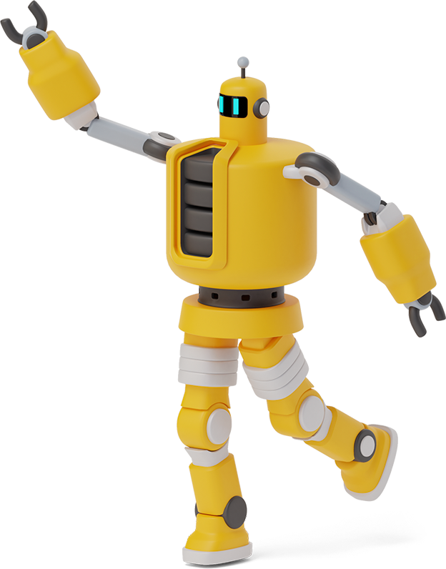
Computer programming

Slide 2
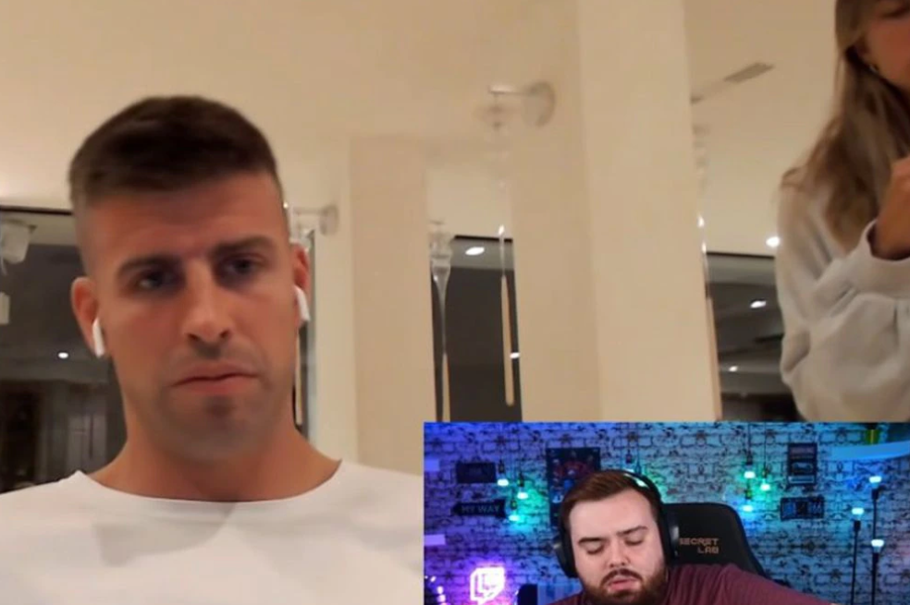
Cameras always on

Slide 3

Agenda
Presentation of the teacher and students(Activity)
Reading of the program
Video, What is PHP?
In Summary

Slide 4
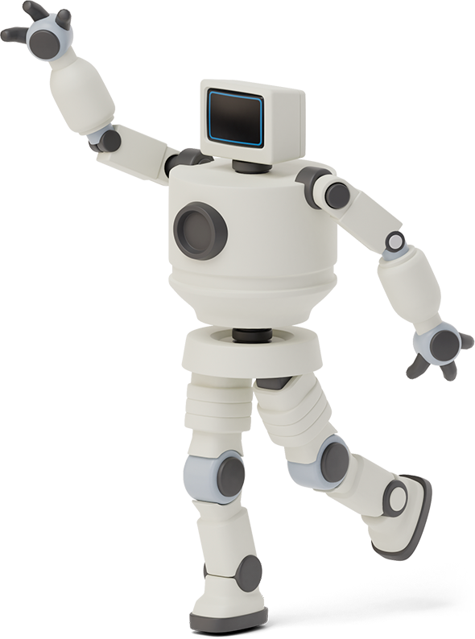

Lie - Truth
3 Truths and 1 Lie
1 Minute to define your Truths and Lies
1 Minute for everyone in the class to choose which statement is false.
1 Minute for the partner to indicate why he/she selected that option to be the false one.
Where are you from?
Why did you choose software engineering?

Slide 5
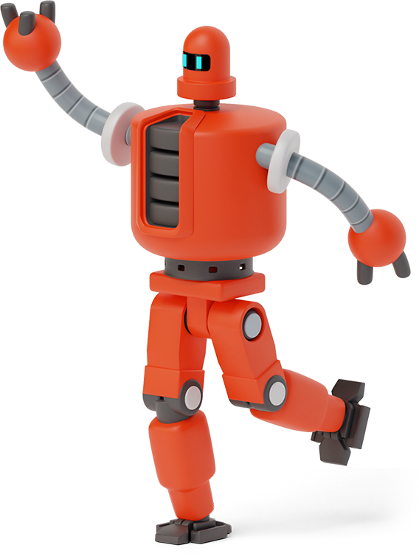
- I have 2 daughters - I like the beach - Support to the LDA(Liga) team. - I am a coding lover
1

Slide 6
Agenda
Presentation of the teacher and students(Activity)
Reading of the program
Video, What is PHP?
In Summary

Slide 7
Agenda
Presentation of the teacher and students(Activity)
Reading of the program
Video, What is PHP?
In Summary

Slide 8
There are several programming languages
Multithreaded and single-threaded languages
https://www.w3schools.com/
PHP

Slide 9
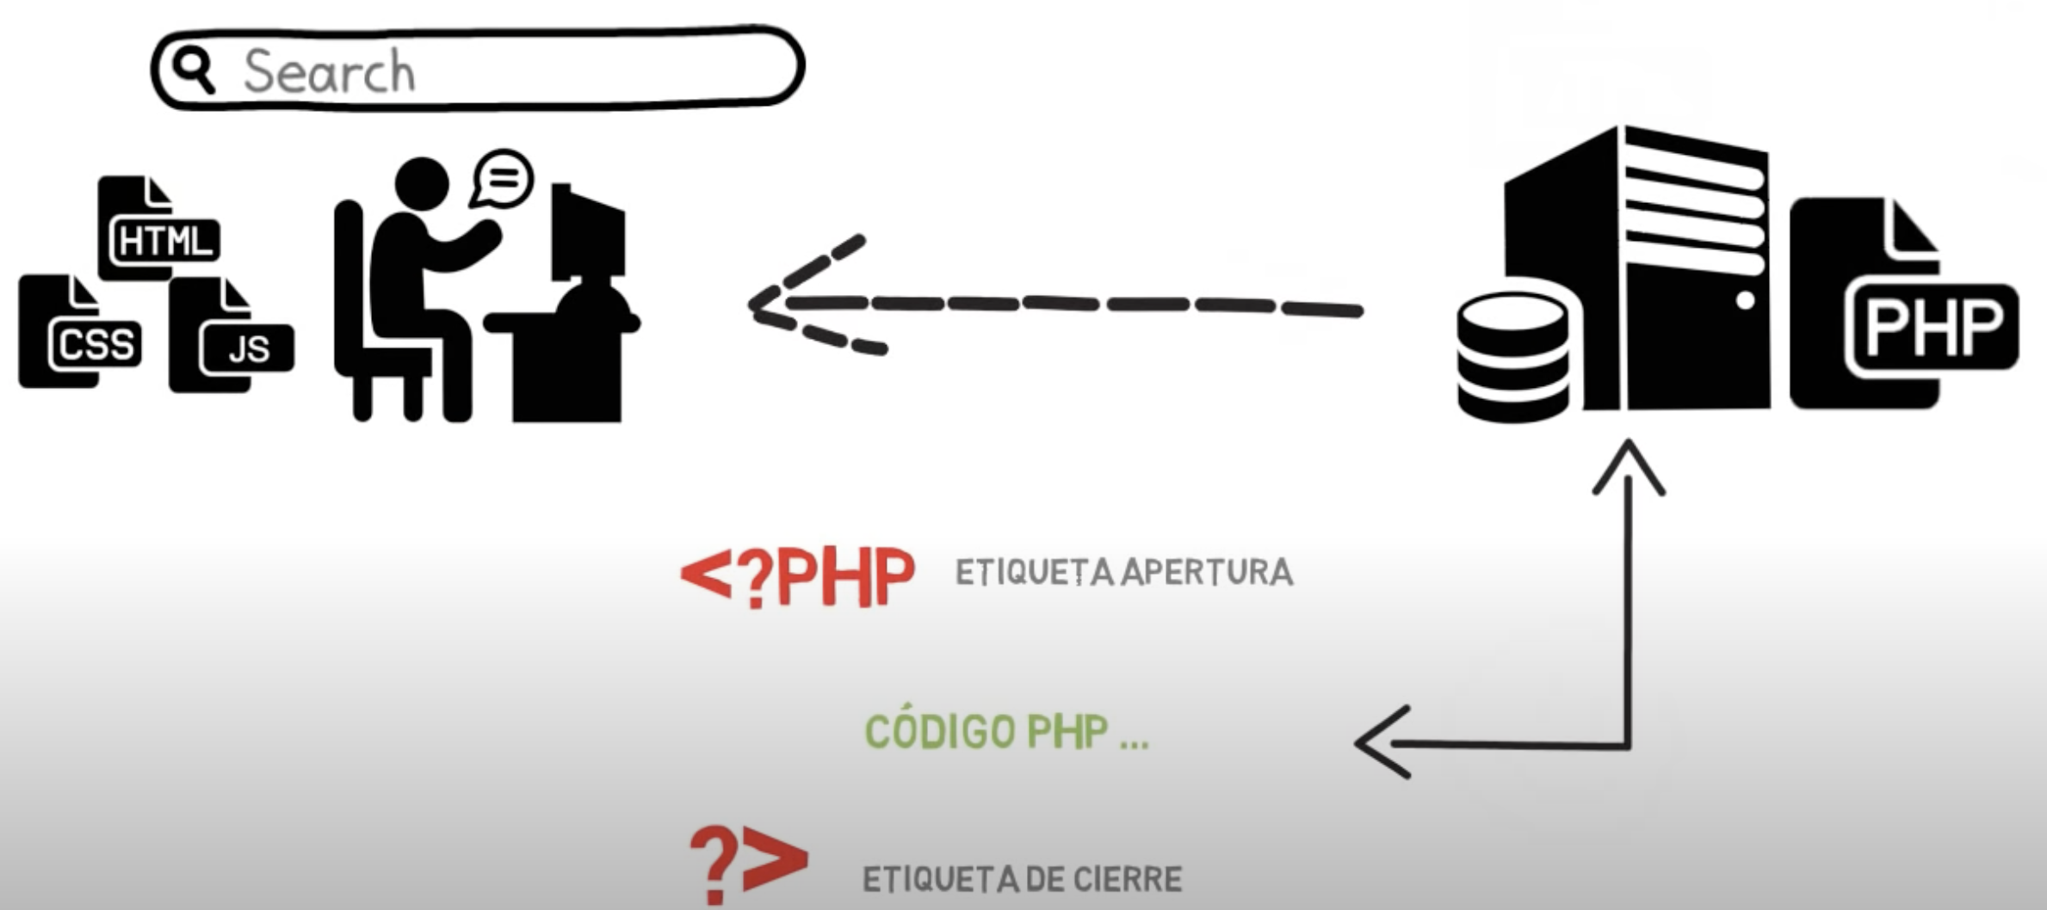

Slide 10

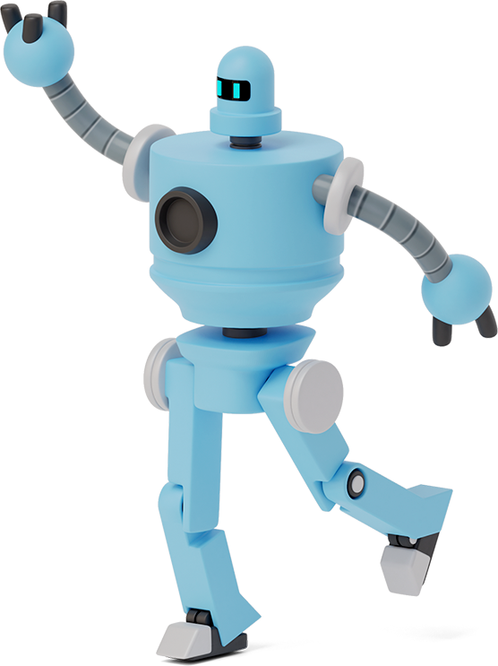
What is PHP?

Slide 11
Advantages
Fast learning
Economy
Good documentation
Disadvantages
Poor error handling: one of the main disadvantages of PHP is that it does not have debugging tools, which are necessary to look for errors and warnings. Low security: PHP is one of the least secure programming languages. To ensure data security, you must have deep technical knowledge and/or work with SQL. A web server is needed: to run the software on the Internet you need to have a hosting.

Slide 12


Slide 13

Frameworks

Slide 14
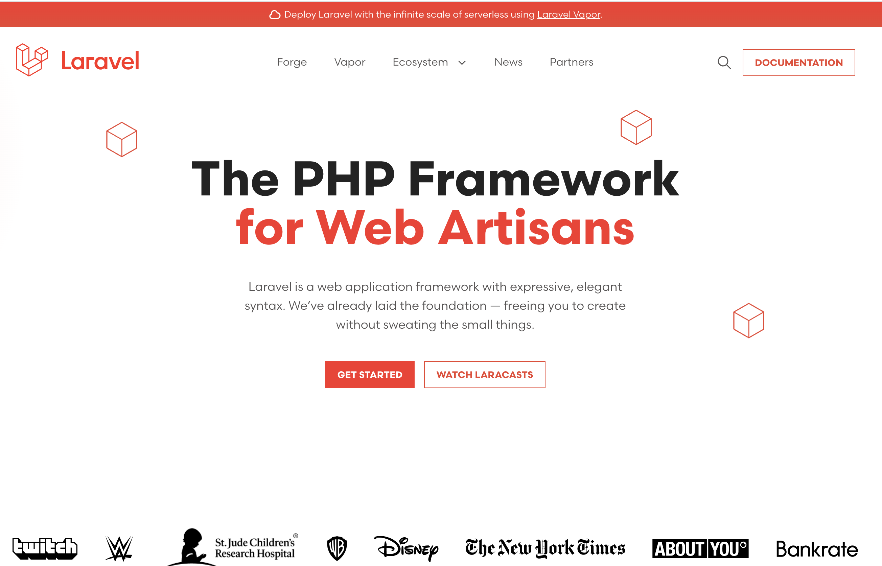
LARAVEL

Slide 15
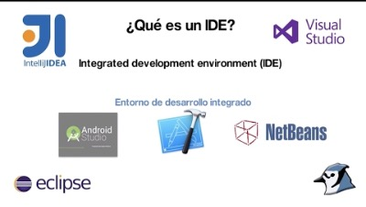
IDE

Slide 16
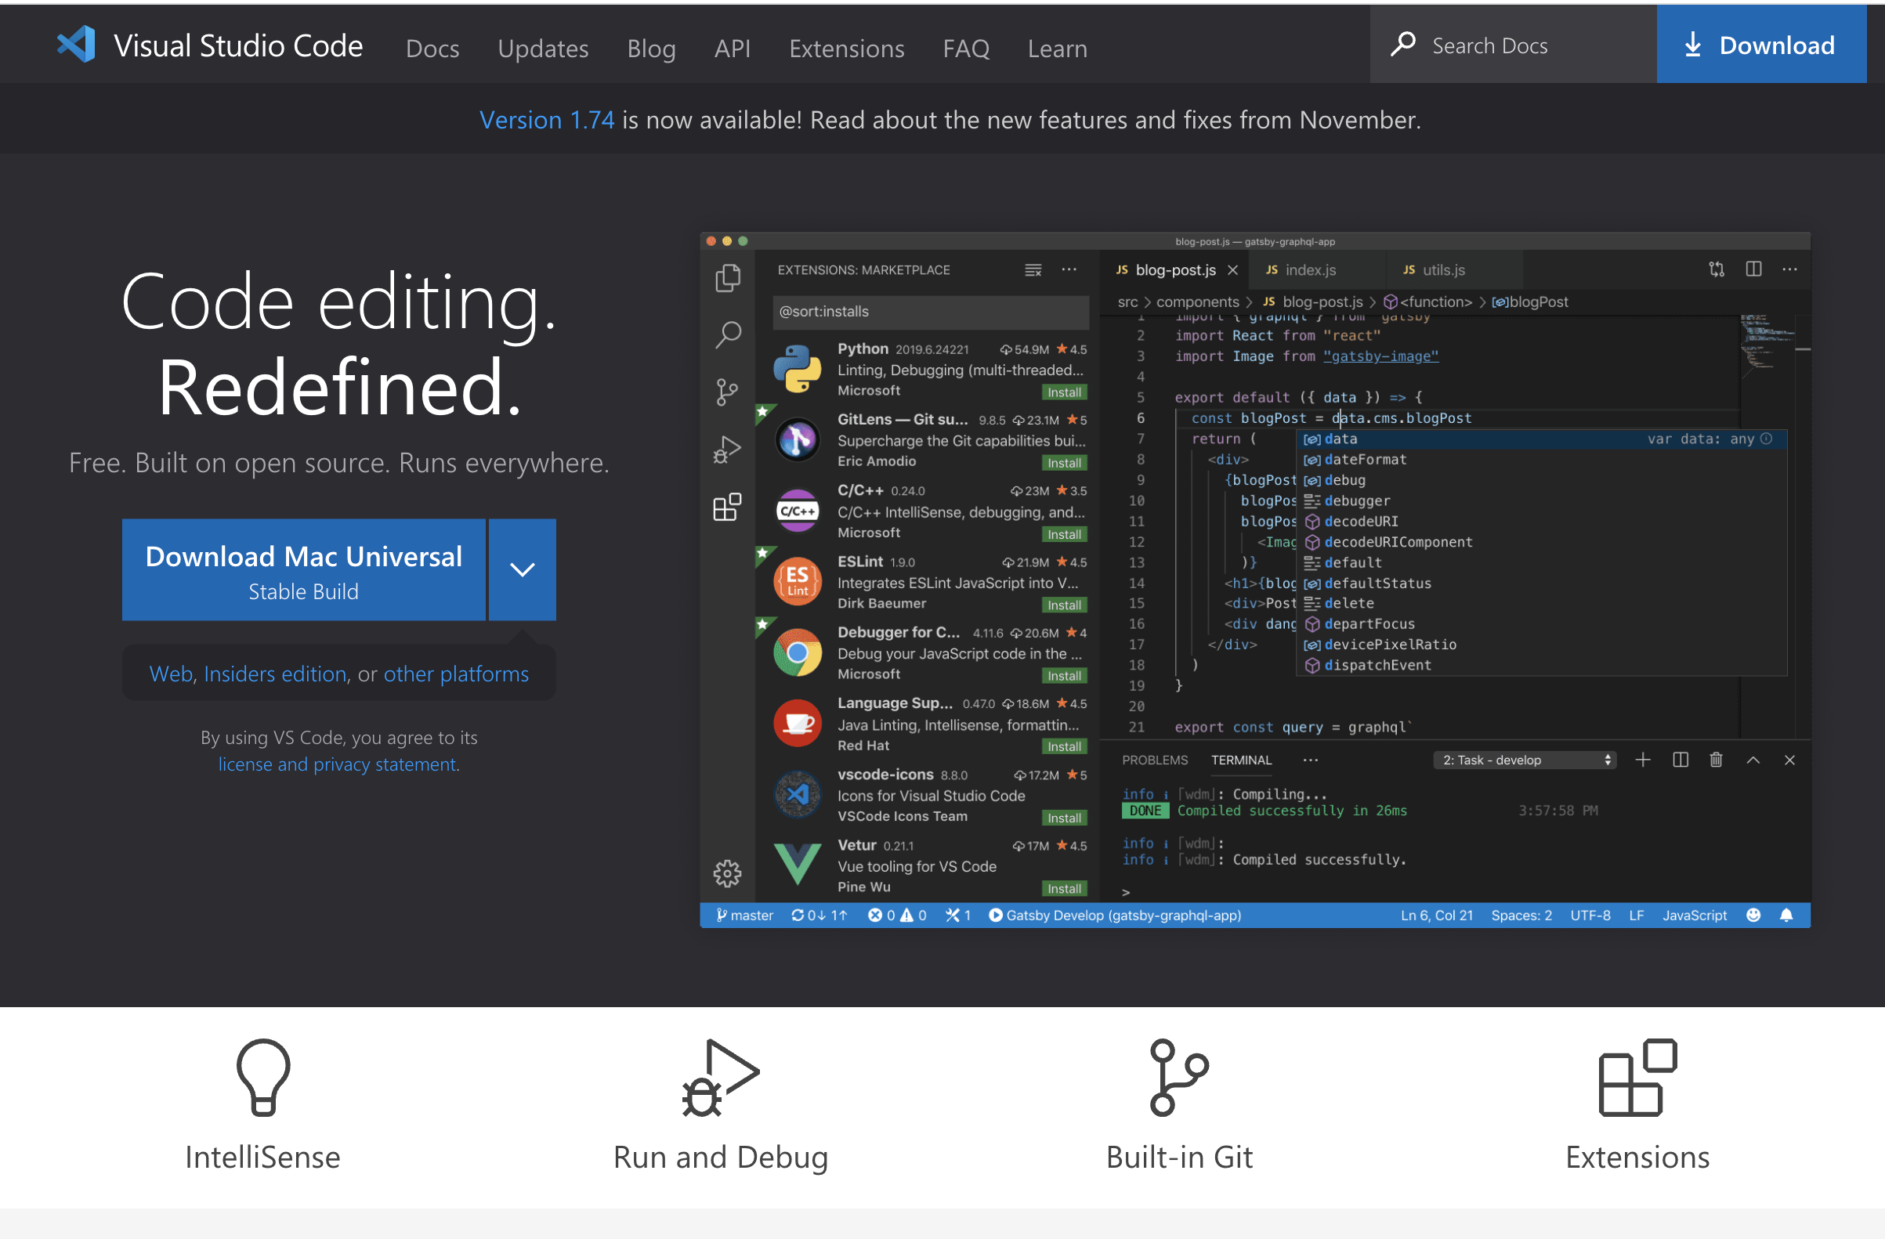
VSC

Slide 17
Agenda
Presentation of the teacher and students(Activity)
Reading of the program
Video, What is a System?
In summary

Slide 18

XAMPP
https://www.apachefriends.org/download.html
Node JS
https://nodejs.org/en/
Composer
https://getcomposer.org/
VSC
https://code.visualstudio.com/
Laravel
composer global require laravel/installer
laravel new example-app
cd example-app
php artisan serve
I appreciate your understanding of the versioning issue.

